Slide 1
Front Shop Fulfillment Strategy Review
September 9, 2003

Slide 2
Contents
Page
Executive Summary 3-4
Background 5-7
Distribution Services 8-11
Procurement Services 12-13
McKesson Profitability Assessment 14
Initial Investigation of Rx Distribution costs 15
Contract Management Assessment 16-18
Summary of Findings 19-20
Recommendations 21-25
Next Steps 26-28
Appendices
  McKesson Service Performance 30-32
  Cost Modeling – McKesson Fees by Banner 33
  McKesson Public Accounts Review 34
  Sources of Data 35
  Assumptions 36
  3PL Providers 37
  Contract Analysis 38-66
  Potential Contract Modifications 67
  Suggested Audit Terms of Reference 68-75
  Contract Management 76-83

Slide 3
1. Executive Summary
Katz spends $1.4bn annually with McKesson
McKesson charges $49.5m for distribution of product to Katz stores (2.4% of Katz sales, comparing favourably to Shoppers’ costs at 2.6% of sales)
Up charges are not representative of real costs:
  McKesson makes $17m profit on back store product,
  loses $14m distributing front store product,
  with an overall net profit of $2.9m on distribution (5.9%)
  as McKesson undercharges for front shop distribution it would cost dramatically more to distribute this product any other way.
McKesson also handles procurement on behalf of Katz and from this makes $10m on cash flow management (prompt payment discounts) and retains about $6.5m in trade discounts.
The profits that McKesson makes from procurement can potentially be managed downward by Katz to its net improvement
The contract gives Katz the flexibility to achieve this but in order to do so Katz needs to develop a rigorous approach to contract management and enhance its purchasing capability
The McKesson contract allows Katz to control the buying relationship with suppliers and hence define prompt payment discounts and how trade discounts are paid
Contract complexity makes administration and understanding of the fiscal relationship difficult. There would definitely be benefits from standardising terms and simplifying calculations if McKesson would agree to this
Katz need first to make high level strategic decisions about how it wants to procure in the future.

Slide 4
1. Executive Summary
Katz should reject the following options:
  Remain with current arrangements and do nothing
    By doing this Katz will continue to receive low service levels and higher costs
  Self provision of distribution
    Katz do not have the resources to manage 500+ additional distribution staff and this activity would take the focus away from core business objectives
  Use 3PL for front shop
    This would significantly increase Katz costs as McKesson is currently under-charging for front shop distribution services. There is no geographic area or category for which it currently makes sense to move away from McKesson
    The entire McKesson pricing agreement would need to be re-negotiated for this option to be attractive
  Buy McKesson Canada
    Katz is only 27% of McKesson Canada sales. Katz would in all likelihood obtain a better return by simply squeezing McKesson margins. If Katz wants to buy McKesson Canada it should first squeeze Mckesson margins as this in turn will reduce the company purchase price
Instead Katz should do the following:
  Manage the McKesson contract vigorously in order to reduce costs and increase service levels to stores (with provisions included in the current contract)
    McKesson service levels are lower than required because Katz is not managing the contract. Katz can increase service levels by actively managing McKesson performance
    The current contract allows Katz to assume greater ownership of supply contracts and reduce procurement costs. If Katz enhances its purchasing capability it will be able to reduce costs by capturing much of the the trade revenues currently retained by McKesson

Slide 5
2. Background: Katz Perceptions
The working relationship between Katz and McKesson is an uneasy one, with some mistrust and frustration
McKesson appears to be working under the terms of the contracts (with a few minor exceptions)
Katz seem to be happy with the service provided by McKesson for Rx and OTC product
Katz are less happy with the front-of-store service
  Stores would like daily delivery
  Product availability is not as high as desired
It is believed that McKesson makes a good profit on Rx and OTC and loses money on front-of-store product (although it has invested in warehouses to handle this case pick product)
Some Katz staff believe that ‘front of store’ product should be handled differently and that McKesson might consider this. McKesson has given no indication that it would entertain such changes.
Katz therefore want to consider alternative options for front shop distribution because of the perception of McKesson shortcomings:
  Does McKesson actually buy front store product at the best price?
  What additional buying leverage does McKesson have for front shop product compared to Katz
  McKesson admittedly has less front store product coverage
  The stores are experiencing inadequate service levels
  Promotions are not being handled effectively
  Retention of trade discounts

Slide 6
2. Background: Services Provided by McKesson to Katz
It is important to point out that McKesson provides two services to Katz:
  Distribution Services
    Inventory management
    Storage of Rx and front store product across Canada
    Distribution of product across Canada
    Delivery of product to stores
  Procurement Services
    Negotiation and administration of contracts with trade suppliers
    Adoption of trade contracts negotiated by Katz
    Purchase of product from suppliers
McKesson charges for distribution services using up charges, and for procurement services by retaining trade discounts and supplier prompt payment discounts
Katz has totally outsourced distribution services to McKesson, whereas both McKesson and Katz have a role in procurement
A key strategic decision for Katz is whether it wants to control the procurement function and selectively allocate buying roles between itself and McKesson or whether it wishes McKesson to own supplier relationships and all procurement decisions
  This high level decision will shape the way Katz should approach contract management and the relationship with McKesson

Slide 7
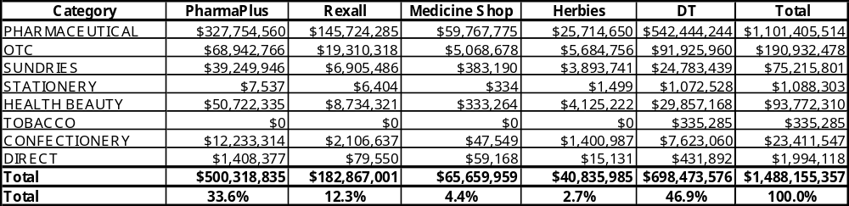
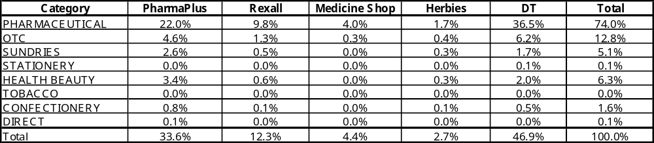
2. Background: Katz Expenditure with McKesson
Katz 2003 expenditure with McKesson is estimated at $1.488bn, 74% being Rx
  Of the remaining 26% half is OTC
Direct = Drop Shipments via McKesson
Calculated using 24 week YTD 2003 file from Don Nicholson (McKesson)

Slide 8
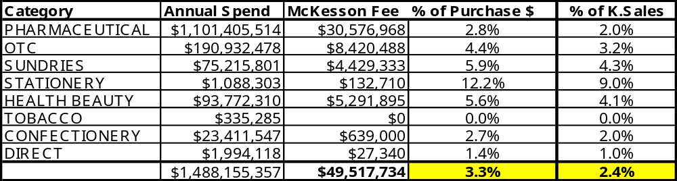
3. Distribution Services: McKesson Charges
Katz has fully outsourced the distribution (warehousing, order picking and delivery of orders to stores) to McKesson
McKesson charging method is very complex and is based on up charges for each product as detailed in the contracts minus volume rebates and prompt payment discounts
Katz pays McKesson $49.5m annually for distribution of product
McKesson net charges represent 3.3% of Katz purchases or 2.4% of Katz sales
McKesson fees include upcharges and volume threshold rebates, not prompt payment or trade discounts. (McKesson fees are also shown by banner in appendix 2)
% of Katz sales based on assumption that Katz sales price is 136% of purchase prices from McKesson

Slide 9
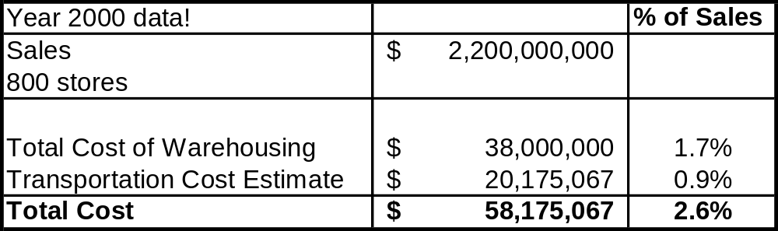
3. Distribution Services: Competitive Cost Comparison
Knowledgeable resources were consulted for information about the Matrix operation run by Tibbett and Britten on behalf of Shoppers Drugmart
If one assumes Shoppers delivery costs are similar to those for Katz then their distribution costs as a percentage of sales = 2.6%
Hence Katz’s distribution costs seem to be competitive at 2.4% of sales
Overall service to stores at the end of March was 88.61% compared to Matrix’s which was in the low nineties. Clearly Katz can improve service levels by diligent management with McKesson
(see appendix 1 for further information about service level issues)

Slide 10
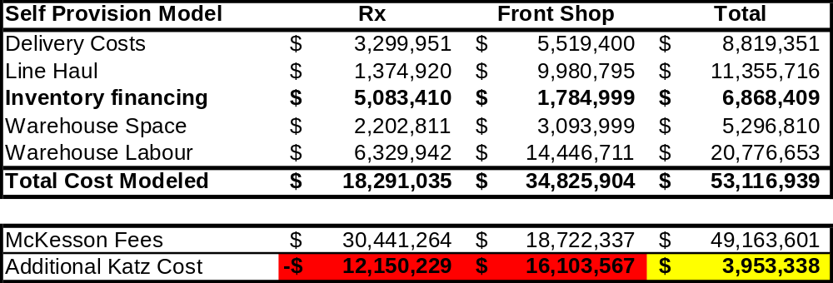
3. Distribution Services: Cost of Self Provisioning
A detailed cost modeling exercise developed distribution costs to be expected for warehouse buildings, warehouse labour, delivery of product (modeling a 3PL undertakes to cost an operation)
The table below summarizes the output from the cost modeling and points out the competitive value of the McKesson distribution services.
Were Katz to self distribute Rx and front shop product it might increase costs by almost $4m
  Self distribution of Rx product would save money, but self distribution of front shop product might cost $16m more than at present
  Analysis revealed that outside of Ontario fees paid to McKesson for front shop distribution do not even cover freight and delivery costs. In no geographic area and for no product department does it make sense for Katz to self distribute or consider alternative options, as it would cost significantly more than at present
Katz would have to first renegotiate charging for Rx distribution services to make alternative options for front shop distribution viable

Slide 11
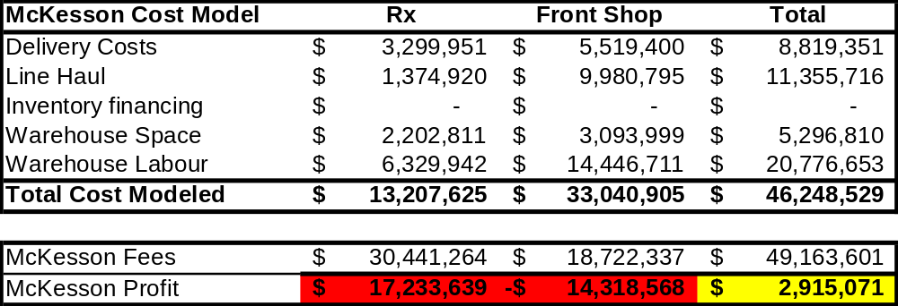
3. Distribution Services: McKesson Profit
In the self provision cost model Katz has to finance two weeks of warehouse inventory
In order to assess McKesson costs it is assumed that current supplier prompt payment terms (eg Net 30 days) means that McKesson does not have inventory financing costs
The table below summarizes McKesson costs and income from fees and hence estimates their profit from providing distribution services to Katz
McKesson charges about $30.4m for Rx distribution and $18.7m for front shop distribution
It is estimated that McKesson makes about $17m profit on the Rx distribution, but loses $14m on front shop distribution. Overall it is estimated that McKesson’s profit on distribution services is $2.9m (representing 5.9% of income from distribution fees)
Profit = 5.9% of
Income from fees
56% profit
-76% profit

Slide 12
4. Procurement Services: McKesson Benefit From Retained Trade Funds
In addition to distribution services Katz also subcontract procurement services to McKesson from which McKesson also makes profit
Research at IBM and discussions with VP of Merchandising would suggest that the following trade discounts likely prevail:
Of the $11.4m available it is estimated that McKesson retains $6.5m (0.3% of Katz sales) as, effectively, a fee for purchasing services
  Drug Trading has a process for identifying further co-op and trade volume discounts and billing suppliers and William Liu is currently investigating the integrity of this process
Trade Discount | Estimated Total Available | Amount Passed onto Katz | Amount Retained by McKesson
Volume Rebate – 4% | $7.75m | $4.9m | $2.85m
Truckload Discount – 2% | $0.75m | $0m | $0.75m
Warehouse Discount – 3% | $2.9m | $0m | $2.9m
Total | $11.4m | $4.9m | $6.5m

Slide 13
4. Procurement Services: McKesson Benefit From Prompt Payment Terms
It is likely that McKesson terms with suppliers are 2% discount net 30 days whereas the Katz payment terms are prompter and discounts lower overall
Katz takes advantage of its prompt payment discounts and, assuming DT customers pay promptly, it is estimated that McKesson benefits $10m overall
If Katz were able to re-negotiate to make prompt payment discounts cash flow neutral Drug Trading franchisees would benefit $3.1m and Katz corporate would gain $6.9m (0.3% of Katz sales)
Prompt Payment Discount | Discount | Net Benefit Retained by McKesson
PharmaPlus | 0.5% Net 10 days On everything | $7.5m
Rexall | 2.25% 21 days Rx only | -$0.6m
Drug Trading | 2% Net 10 days Rx only | $3.1m
Total |  | $10m

Slide 14
5. McKesson Profitability Assessment: McKesson Benefit/Profit Summary
The table below is an estimate of McKesson’s benefit, or profit, from services provided to Katz and shows overall Katz costs as a percentage of sales
The table clearly highlights that McKesson makes most of its profit from purchasing (retained trade discounts and prompt payment discounts)
Distribution costs ($49.5m) represent 2.4% of sales, and the benefit McKesson retains from trade discounts and prompt payment ($16.5m) represents 0.8% of sales
The total cost of McKesson services to Katz is therefore $66m or 3.2% of sales
The McKesson contract affords Katz some ability to lower this procurement cost
  (A review of McKesson public accounts in order to understand profitability is shown in Appendix 3)
Service Provided to Katz | McKesson Benefit/Profit | Total Cost to Katz | Cost as a % of Katz sales
Total Distribution | $2.9m | $49.5m | 2.4%
Purchasing, Retained Trade Discounts | $6.5m | $6.5m | 0.3%
Purchasing, Benefit from Prompt Payment Discounts | $10.0m | $10.0m | 0.5%
Total | $19.4m | $66.0m | 3.2%

Slide 15
6. Initial Investigation of Rx Distribution Costs
Whereas McKesson makes a significant loss on front shop product distribution,
its Rx distribution business is very profitable
Corporate Rx distribution fees account for $16m+ of up charges
Preliminary analysis of Rx throughput in Ontario reveals the following:
  19 SKU’s (3 of which are Aventis – Altace Capsule) represent $60m of purchases
  The net fees from McKesson for distribution of these products in Ontario is $1.39m, accounting for 25% of McKesson Rx fees in Ontario
It is very likely that Katz could procure these drugs direct from the manufacturers either with direct delivery by the manufacturer or via a warehouse run by an organisation like UPS
We therefore suggest investigating the impact of alternative distribution methods for these Rx products
  NB Katz Corporate gets a 11% fee discount if it buys more than about $388m in 2003
    Katz Corporate currently buys about $560m of Rx
    Thus it could buy up to $182m direct without sacrificing the 11% discount for product distributed by McKesson
These calculations are high level and preliminary and need further analysis

Slide 16
7. Contract Management Assessment: Contract gives Procurement Flexibility
Contract flexibility is provided by the following agreement clauses:
  Option for Katz to negotiate price directly with suppliers
  Option for Katz to buy direct from suppliers
  Option for Katz to employ secondary suppliers
  Option for Katz to jointly negotiate (with McKesson) for additional supplier prompt payment discounts
  Benchmarking McKesson prices
Katz could significantly reduce costs by taking a greater role in the buying process to achieve the following:
  Negotiating contracts in such a way that Katz receives the majority of trade revenues, rather than McKesson and negotiating to make prompt payment discounts cash flow neutral
  Forward buying savings: Potential savings in the neighborhood of 10-20% of acquisition costs for particular SKU’s
  Focus purchasing power strategically : Managing and controlling selected purchase orders in-house will allow Katz to leverage purchasing power on strategically selected products
  Ability to take advantage of truck load deliveries and receiving at one warehouse rather than several

Slide 17
7. Contract Management Assessment: Considering the Longer Term Contract Relationship
This strategy reviews positions a short term (BR1/BR2) perspective and a longer term (BR3+) perspective
Should Katz fully control its supplier relationships?
    Katz needs to assess whether in the longer term it wishes McKesson to control supplier relationships or whether Katz should have full control
      In order to take full control, procurement capability at Katz would need to be enhanced
Future Partnership approach
    Katz also need to consider next steps in light of whether it wishes to continue its relationship with McKesson in the longer term
    Currently there are few options available to Katz
      It does not have the skills to directly manage a distribution operation of 500+ staff
      It cannot switch wholesale suppliers during the Term of the agreements (2008-2011)
      It only has limited ability to switch Rx suppliers
      Changes in front shop distribution would be costly and would require agreement

Slide 18
7. Contract Management Assessment
At present there is no contract management; it is on auto-pilot
  With changeover in senior management there is no institutional understanding nor administration of the agreements, with the notable exception of Drug Trading
  Senior management lack knowledge of a highly complex contract and its flexibility to benefit Katz
  Katz is performing low-level administration of T&C’s only
    Continuing functionality derives solely from clerical understanding, automated Katz application of contract rules and process, and reliance on McKesson systems and administration
  Up charges listed in McKesson contracts are different to those referred to by Drug Trading distribution operations, which are different again to those listed in the McKesson system. No evidence yet found of suitable change administration
There is need to establish clear accountability for managing the McKesson contract relationship
At present the only executive-level contract governance is represented by issue-driven executive intervention

Slide 19
8. Summary of Findings
Distribution Services
McKesson charges $49.5m for distribution services and is making about $2.9m profit i.e. 5.6%, which in itself is not unreasonable
Up charges are not representative of real costs and McKesson makes $17m profit on back store and loses $14m distributing front store product store
These distribution costs represent 2.4% of Katz sales and are competitive compared to Shoppers costs at 2.6%
As McKesson undercharges for front shop distribution it would cost dramatically more to distribute this product any other way.
  There is no geographic area/product grouping where it would be cheaper for Katz to distribute differently.
  Katz might be able to save money by considering alternative options for distributing high value Rx product, but this would been seen as confrontational by McKesson (requires further investigation)

Slide 20
8. Summary of Findings
Purchasing Services
Katz purchases $1.488bn of product from McKesson
  McKesson retains approximately $6.5m in trade discounts
  McKesson benefits $10m from prompt payment discounts
The structure of the deal encourages McKesson to be highly effective as a Distributor (costs directly impact their margins); but does not incent them as a Buyer
    fees are a percentage of Cost of Goods - higher the price, better the fee
    McKesson distribution costs may be minimised, rather than purchasing and supplier economies optimised
Generally Katz are happy with the service being provided. VP’s of Merchandising believe that
  A change of distributor would not be beneficial, but an enhanced Katz buying function might be able to reduce costs by up to 2%
The deal allows Katz to step into the buying role: directly negotiating price and ordering product, with McKesson delivery and administration
Costs could be reduced by regaining supplier relationships and restructuring terms. In order to do this Katz need to develop greater procurement expertise i.e. build a buying department e.g. Katz could negotiate with a supplier:
    a lower list price in lieu of trade discounts, the Up charge fee payable to McKesson is minimized
    a lower list price in lieu of prompt payment discount, Katz is advantaged by the lower list price while McKesson has lost a prompt payment discount which makes up part of its margin
    Note: The Drug Trading Agreement, due to its terms, is largely impervious to such manipulation

Slide 21
8. Summary of Findings
Contract Management
Management of the contract is presently on auto-pilot.
  Katz is performing low-level administration of terms and conditions only
  Senior management lack knowledge of a highly complex contract and its flexibility to benefit Katz
  Some fees are altered from contract values with no evidence yet found of suitable change administration
Service levels are not being managed.
  Service level reporting had lapsed, only recently being resurrected
  McKesson claims to be meeting contracted service levels, but failure reasons may be doubtful and the issue remains that store replenishment service levels are lower than competitor levels

Slide 22
9. Recommendations
Katz should reject the following options:
  Remain with current arrangements and do nothing
    By doing this Katz will continue to receive low service levels and higher costs
  Self provision of distribution
    Katz do not have the resources to manage 500+ additional distribution staff and this activity would take the focus away from core business objectives
  Use 3PL for front shop
    This would significantly increase Katz costs as McKesson is currently under-charging for front shop distribution services. There is no geographic area or category for which it currently makes sense to move away from McKesson
    The entire McKesson pricing agreement would need to be re-negotiated for this option to be attractive
  Buy McKesson Canada
    Katz is only 27% of McKesson Canada sales. Katz would in all likelihood obtain a better return by simply squeezing McKesson margins. If Katz wants to buy McKesson Canada it should first squeeze Mckesson margins as this in turn will reduce the company purchase price
Instead Katz should do the following:
  Manage the McKesson contract vigorously in order to reduce costs and increase service levels to stores (with provisions included in the current contract)
    McKesson service levels are lower than required because Katz is not managing the contract. Katz can increase service levels by actively managing McKesson performance
    The current contract allows Katz to assume greater ownership of supply contracts and reduce procurement costs. If Katz enhances its purchasing capability it will be able to reduce costs by capturing much of the the trade revenues currently retained by McKesson

Slide 23
9. Recommendations: General
Removing front shop distribution from McKesson isn’t very attractive because:
  McKesson would be making much more profit just by retaining Rx distribution, and it is extremely unlikely that they would agree to a significant reduction in fees for Rx distribution
  Katz would have to assume responsibility for the costs associated with closing front shop distribution warehouses and staff reductions
  This amount of change would mean that Katz would remove management focus from other more important projects and management objectives
It is suggested that managing McKesson’s margins would pay greater dividends, with less risk, than any strategy of assuming ownership, given that KGC business represents only some 27% of the firm’s revenue base
Instead it is recommended that Katz try to use the current contract to its advantage by taking greater control over its supply contracts ($1.4bn) and using a discplined contract management approach to increase McKesson service to stores, and increasing the discipline
Katz’s next step is to make a number of strategic decisions:
  To decide if McKesson is the supplier than Katz wants to work with and for how long
  To decide whether Katz wants to own the relationship with suppliers in the future or whether a wholsesale supply agreement is acceptable
  Whether Katz sees a partnership or adversarial approach as preferable
Clearly the approach will be significantly different is Katz wants to build a long term partnership approach, compared to a short term adversarial approach, which could lead to:
  A very difficult and strained working relationship
  Neither party helping the other meet strategic objectives, including profitability
  McKesson asking to re-negotiate {or defaulting on contract before Katz is ready to manage this outcome}

Slide 24
9. Recommendations: Distribution and Purchasing
Distribution
Continue to employ McKesson for Front Shop as well as Back Shop Fulfillment.
  Katz has little option: present agreements appoint, with suitable safeguards, McKesson as Katz’s exclusive wholesale distributor of Products during a Term extending to March 31, 2011 for Pharma Plus and Pharmx Rexall, February 28, 2008 for Drug Trading.
Investigate the costs of distributing high value Rx product in greater detail
Purchasing
Decide whether to strategically own the purchasing function and enhance capability
Regardless, assert purchasing leadership, particularly for Front Shop product
  Agreement Terms allow Katz to directly negotiate price and purchase Products directly from manufacturers should it wish to do so. For many Front Shop Products, McKesson brings no value to the supply chain aside from delivery.
  Upgrade margins in the relationship by employing contract options to:
  (a) improve McKesson pricing, where possible, by direct negotiation with suppliers on
  selected top selling products, buying directly and drop shipping
  (b) share in supplier prompt payment discounts by re-negotiating.
  (Presently all supplier discounts, where negotiated solely by McKesson, accrue to their benefit.)
Require McKesson to continually demonstrate “prudent Buyer” behaviour
  McKesson has contract covenants to provide competitive pricing and act as a prudent buyer.

Slide 25
9. Recommendations: Contract Management
Establish clear accountability for managing the McKesson contract relationship within finance and operations
Commence vigorous management of the relationship
  Institute a coordinated contract management across all agreements
  Institute contract governance between the parties
  Commence enforcement of all Katz rights in the agreements and audit McKesson fulfillment of Agreement Terms and Conditions
Obtain assurance of value by benchmarking price and service levels
  The Pharmx Rexall Agreement provides that Katz may, after October 2002 and following a twelve month notice, “seek from time to time alternative pricing quotations … with McKesson having first opportunity to match any such pricing”
As part of operational contract management start to manage store service levels by
  Identifying reasons for under performance and working with McKesson to resolve the causes in order to avoid lost sales
  Assessing inventory levels to address “manufacturer stock-outs”
  Setting up a store operations team to explore why so many orders are placed for wrong or obsolete product, thus leading to lower store service levels
Request specific contract terms be harmonized for ease of administration
Assess need to renegotiate selected financial terms
  Consider attempting to re-negotiate prompt payment discounts to make them cash flow neutral (reducing McKesson profit)
  Is Katz materially disadvantaged by the terms with McKesson? Are the above recommendations when actioned sufficient to materially alter margin results and dissipate such a perceived disadvantage? When an appropriate time has passed for judgement, Katz may wish to re-negotiate other selected financial terms
For greater detail on Contract Management recommendations, see appendix 11

Slide 26
10. Next Steps
Strategic Management
Ensure all historical agreements between Katz and McKesson are understood
Determine whether McKesson is the long term partner and whether partnership approach is desirable
Determine whether to own procurement and relationship with suppliers
Agree how to interact with McKesson at a senior level and set up quarterly meetings
Develop presentation for McKesson, showing future vision, cost and service objectives and how Katz sees McKesson behaving to meet those objectives and hence be a partner in the longer term
Merchandising
Undertake ABC analysis to understand what products generate the most profit to Katz and hence resolve conflicting objectives for merchandising managers:
  Items which require the most procurement focus to generate the greatest acquisition cost savings
  Items which require the most inventory management to ensure high store service levels
  Items which require the most promotions management to draw customers into stores
  Items which require the most category management to generate margins
  Iems which require the most administration due to frequent price or contract changes
Enhance Katz purchasing capability in order to
  Handle these conflicting objectives
  Increase direct negotiation of contracts with aims of strategic buying, increased drop shipments minimising up charges, regaining lost trade discounts and lost distribution efficiency savings

Slide 27
10. Next Steps
Contract Management (see appendix 11 for full description)
Day to Day Operating Aspects of Contract Management
  Appoint contract manager and define supporting relationships
  Communicate terms of contract internally within Katz
  Set up monthly meeting of interested parties within Katz, led by contract manager with operational and finance department input
  Set up monthly meetings with McKesson
  Develop summary document which lists McKesson purchases, discounts, trade funds, rebates and service levels, which is then used to manage McKesson
  Manage performance improvement projects:
    Store service level improvement project
      Enhance reporting and coding of service deficiencies
      Set up monthly service meetings
      Instigate meetings with key Rx and OTC suppliers
      Manage store operations project to investigate replenishment process issues with stores
      Initiate rotating store satisfaction survey and share with McKesson
    Design and build data reports to provide information to be used to manage McKesson
    Assist with Merchandising Projects
      ABC analysis of suppliers, products and stores to understand priorties
      Share information with McKesson and ensure McKesson holds sufficient inventory of items
    Promotions improvement
      Form joint team to improve the way promotions are managed

Slide 28
10. Next Steps
Contract Management (see appendix 11 for full description and org. structure)
Renegotiation and relationship management aspects of contract management
  Establish/fill in any gaps in the contract file and make accessible to staff
  Define contract management governance/org structure
    e.g. roles of senior management and reporting relationship to finance and merchandising
  Discuss Casper project impacts with Mckesson
    Integration with McKesson systems
    Contractual adjustments
  Inform McKesson of intention to benchmark Rexall contract in 12 months time
  Compare and benchmark Kohl and Frisch charges to those of McKesson
  Audit McKesson charges using KPMG
  Re-negotiate select terms of contracts for substantive issues e.g. prompt payment discounts
  Simplify terms and methods of charging wherever possible to allow organisation to understand and thus make the correct business decisions especially merchandising managers
    Harmonization terms for administrative convenience or
    Rationalise Rexall and PharmaPlus contracts to one contract
    Simplify terms especially charging and rebates to make them understandable

Slide 29
11. Appendices
Page
McKesson Service Performance 30-32
Cost Modeling – McKesson Fees by Banner 33
McKesson Public Accounts Review 34
Sources of Data 35
Assumptions 36
3PL Providers 37
Contract Analysis 38-66
Potential Contract Modifications 67
Suggested Audit Terms of Reference 68-75
Contract Management 76-83

Slide 30
Appendix 1:
McKesson Service Level Performance
McKesson Service Level performance reports are received only sporadically.
McKesson overall service to stores at the end of March was 88.61% compared to Matrix’s which was in the low nineties.
The McKesson service reports highlight the following issues:
Pharmaceuticals and OTC
  Where item is in stock at McKesson, service levels are high but overall service levels are impacted dramatically by what McKesson terms ‘supplier unable to supply”
  There are 3 potential reasons for this:
    Katz does not provide forecasts, hence demand may be sudden and unexpected
    McKesson may not be carrying sufficient stock in light of supply issues and low service levels (inventory holding is expensive and reduces McKesson profit)
    There is a significant supply issue within the Pharmaceutical industry
Front Shop
  In the main McKesson service levels are acceptable, but this is negatively impacted by stores ordering incorrect or obsolete items
  Whereas stores order correct Rx or OTC items, the process for ensuring stores have an up-to-date listing of front shop replenishment product seems to be in-effective
Corrective Action Required
  Work jointly with McKesson to define amount of Rx and OTC stock to hold to meet service levels
  Work jointly to address industry supply issues and investigate supplier under-performance
  Katz Store Operations and McKesson to investigate front shop replenishment processes

Slide 31
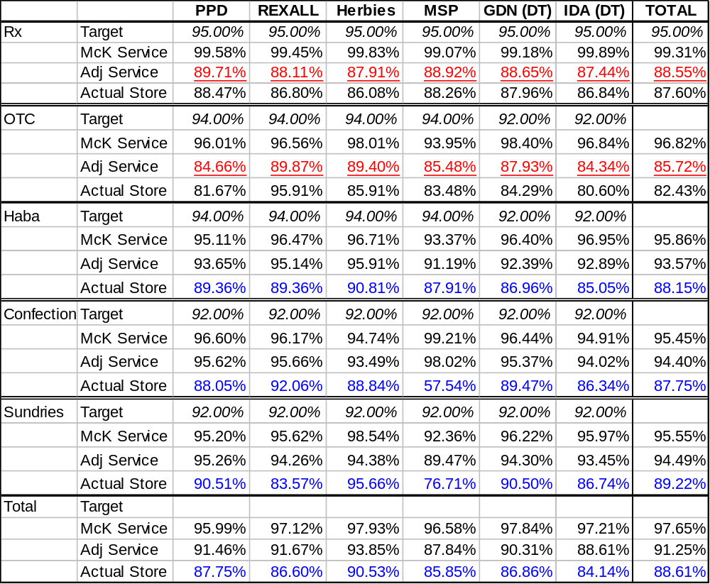
Appendix 1:
McKesson Service Level Performance
Rx = Supply Issue:
Insufficient inventory
Supplier unable to supply
OTC = Supply Issue:
Insufficient inventory
Supplier unable to supply
Haba = Process Issue:
Insufficient inventory
Replenishment process
ineffective
Confection = Process Issue:
Insufficient inventory
Replenishment process
ineffective
Sundries = Process Issue:
Insufficient inventory
Replenishment process
ineffective

Slide 32
Appendix 1: McKesson Service Level Performance
Comparative Marketplace Service Levels
Knowledgeable sources were again consulted to compare McKesson performance to Matrix:
Matrix performance can be summarised as follows:
  Pick Accuracy : 99.75%
  Service to stores : low 90%
  On time delivery: 95%
  Front of store product NOT delivered daily
McKesson overall service to stores at the end of March was 88.61% compared to Matrix’s which was in the low nineties.
Clearly there is much room for improvement but McKesson’s performance is not too far out of line with what competitors are experiencing. The difference might be explained by:
  Greater use of planning systems at competitors
  Competitors have full control over service level by controlling both buying function and defining inventory levels held
  McKesson business objectives (minimise inventory costs) are not entirely in line with Katz’s objectives

Slide 33
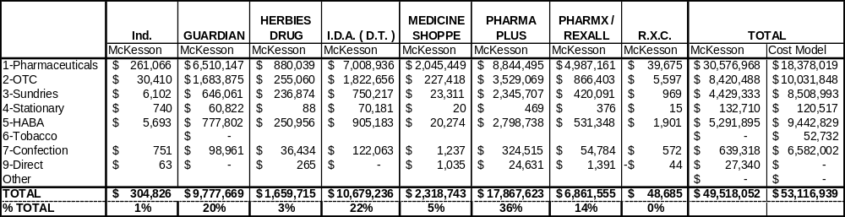
Appendix 2: Cost Modeling
Comparison of McKesson fees by banner with total modeled cost
A very detailed cost benchmarking exercise was undertaken to understand what distribution costs should be expected for warehouse buildings, warehouse labour and delivery of product (this is the type of modeling a 3PL undertakes to cost an operation)
The table below summarises McKesson fees by banner and compares them to the results of the distribution cost modeling
The distribution model re-iterates the competitive value of the McKesson distribution services.

Slide 34
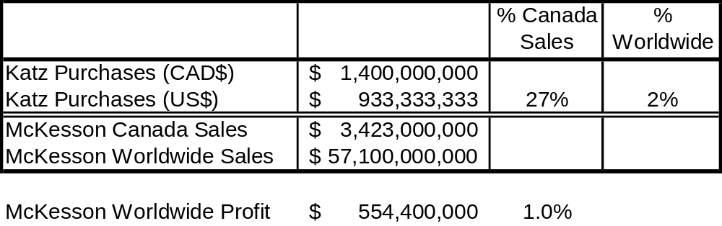
Appendix 3:
McKesson Public Accounts Review
McKesson public accounts were reviewed to understand McKesson turnover and profitability
Katz represent 27% of McKesson Canadian sales and 2% of McKesson worldwide sales
McKesson makes 1% profit on world sales and if one assumes similar profitability worldwide then profit in Canada would be about $33mUS/$49m CAD
  This would therefore indicate that McKesson is not making significantly more on this contract compared to other contracts which it operates

Slide 35
Appendix 4:
Sources of Data/People Interviewed
Interviewees:
        Mike Martin
        Rob Shaver
        Chris Rath
        Josette Arsenault
        William Liu
        Jonathan Alpert
        Craig Taylor
Sources of Data:
        YTD purchases file from McKesson plus service level reports
        Actual fees/discounts and prompt payments discounts from Katz finance
        Assumptions as agreed with Rui Martins (see appendix 6)
        Rx sales files for Ontario
        Store delivery schedules

Slide 36
Appendix 5:
Assumptions
Demand Information
  McKesson purchasing file provided by Don Nicolson pro-rated from 24 weeks YTD to full 2003 year
  $ per unit by category from Katz reports and validated with Rui Martins
  % units / case agreed with Rui Martins
  Units per case by category from Katz reports and validated with Rui Martins
  Matrix warehouse productivities used to calculate warehouse labour required in cost modeling
  2 weeks worth of inventory financing costed at 12%
  530,000 sq ft of warehousing space assumed at $10/sq ft
  Katz sales = 136% of Mckesson purchases i.e. 36% markup
Freight
  Store deliveries as per contract (2 totes of Rx – 50lbs) and 3 pallets of front store per delivery
  ATS rate tables discounted by 15% for Rx. Front shop delivery rates obtained from UPS and validated with Canada Cartage
  On days where there is both Rx and front shop deliveries Rx assumes 20% of delivery cost
  Line haul is 44 pallets per truck
Trade discounts (handled as per contract agreement)
  Volume rebate average of 4% for 100% of business
  Truck load discount of 2% for 20% of business
  Warehouse discount of 3% for 50% of business
  Prompt payment terms from suppliers to McKesson assumed to be 2% Net 30

Slide 37
Appendix 6:
3PL Providers
Front Shop:
        Exel Logistics
        Tibbett and Britten
        Ryder
        UPS
        Schenker
        K&N
        Numerous others
Back shop:
        UPS
        McKesson Outsourced Logistics
        Kohl and Frisch (distributor therefore not acceptable with current contract)
        Source Medical (distributor therefore not acceptable with current contract)

Slide 38
Appendix 7:
Contract Analysis
 | Contract Features (contract reference) | Actively Employed | Comment | Initiative Required
1 | DIRECT PRICE NEGOTIATION BY PURCHASER (P+: 1(1), 3) (Px: 1(1), 3) (DT: 1.1(b), 3.7.2) | YES | 1(1): “The Purchasers may purchase Products directly from manufacturers should they wish to do so.” 3: “From time to time the Purchasers may be able to negotiate contract pricing for Products with specific suppliers which is better than McKesson’s current Acquisition Cost”1.1(b): “Acquisition Cost means the lower of a) or b):The suplier’s cost to McKesson…For exclusive lines of Products or Promotional Products; the cost negotiated by DT with suppliers…” 3.7.2: “DT shall have the right to place orders and be billed directly by suppliers for any products that are exclusive to DT. … the Products will be distributed by McKesson to Customers in accordance with this Agreement.” | Need to explore expanded usage, particularly for expensive pharmaceutical products

Slide 39
Appendix 7:
Contract Analysis
 | Contract Features (contract reference) | Actively Employed | Comment | Initiative Required
2 | BUY DIRECT OPTION WITHIN EXCLUSIVITY FOR MCKESSON (P+: 1(1)) (Px: 1(1)) (DT:2.1.1) | YES | 1(1): “Each of the Purchasers hereby appoints McKesson, effective …, as its exclusive wholesale distributor of Products (as defined in Section 4) during the Term … The Purchasers may purchase Products directly from the manufacturers should they wish to do so.” 2.1.1: “Drug Trading hereby appoints McKesson as its exclusive wholesale distributor of Products to DT Customers (other than Products handled by Drop-Shipments).” DT: $37 M/yr direct, $80K~$100K/month thru McK, 2 FTE’s, 1000 transactions/day, most drop shipments are direct KGC, under terms of the agreements, employs at least two secondary suppliers today: Lumsden Bros (produce). Kohl and Frisch (McKesson can’t supply) and drop ships direct to stores | KGC is free to negotiate and buy direct for Front Store needs, as well as Back Store, as long as it respects McKesson’s contract rights as an exclusive distributor. It is to KGC’s advantage to employ McKesson in its distribution role, particularly for Front Store, as it appears that KGC is getting McKesson distribution services very cheaply. A strategic purchasing program should be easily initiated with insignificant staff impact given that but 19 SKUs out of 4,000 (representing $120M of KGC annual sales, $2.8M in up-charge fees paid McKesson) within the Corporate business represent 9% of Rx up-charge fees paid to McKesson.

Slide 40
Appendix 7:
Contract Analysis
 | Contract Features (contract reference) | Actively Employed | Comment | Initiative Required
3 | SERVICE FEE/UPCHARGE (by full and part case shipment) (P+: 6) (Px: 6) (DT: 3.1) | YES | DT has audited McKesson pricing and reconciled all discrepancies as of Aug 14; tries to do this semi-annually. Prices have changed once, Feb 2002. DT is renegotiating its contract, almost done Rates in Drug Trading supply agreement (very complex) are qualified by an inflation rider and a performance discount (very complex). | Almost half of 120 fees examined are at variance with the contract record. Variant fees should be audited to validate the new fee. A pricing change log should be put in place as part of an overall contract change log, to develop integrity for contract change management and pricing administration.

Slide 41
Appendix 7:
Contract Analysis
 | Contract Features (contract reference) | Actively Employed | Comment | Initiative Required
4 | PROMPT PAYMENT DISCOUNT (to McKESSON) (P+: 10(3)) (Px: 10(3)) (DT: 3.6.9) Rx Non Rx | YES | Corp: Fully automated process. Stores validate their charges (invoices identify per store purchases) to give final invoice payment approval. Prompt payment discount is credited back to stores. DT: Responsible only for Enterprise A store invoices. (There is a contract amendment of 1999.) $200K/month, $2.4 M, for Enterprise A stores Pharma Pharmx Drug Plus Rexall Trading 0.5% 10 days 2.25% 21 days 2.0% 10 days 0.5% 10 days 0 0 | Harmonization of discounts between Pharma Plus, Pharmx Rexall and Drug Trading Supply Agreements should be examined. At a minimum, why should the two corporate Agreements differ? If an improved discount for Rexall was appropriate in the past, are historical reasons for a difference still valid today? Should KGC wish to renegotiate contract terms, it can seek to have prompt payment terms be cash neutral between KGC-McKesson and McKesson-Suppliers. (See 5 below.) If McKesson is obtaining 2% terms from suppliers, it is obtaining $28M in prompt payment discounts from suppliers while returning $6 million to KGC for prompt payment. (Note KGC could argue for parity treatment for only those discounts pertaining to Corporate stores and DT Enterprise A stores.)

Slide 42
Appendix 7:
Contract Analysis
 | Contract Features (contract reference) | Actively Employed | Comment | Initiative Required
5 | SUPPLIER PROMPT PAYMENT DISCOUNTS (P+: 2(6), 10(5)) (Px: 2(6) , 10(5)) (DT: 3.8) | YES | Retained by McKESSON 2(6): “Suppliers’ prompt payment discounts will not reduce the Acquisition Cost of Products and shall be the property of McKesson.” 10(5): “Any supplier published regular payment terms provided to McKesson and the trade in general, will not be passed on to the Purchasers or the Franchised Stores” 3.8: “All forms of revenue related to wholesale purchases such as supplier cash discounts for prompt payment or volume rebates… will remain the property of McKesson … .” | If KGC wishes to renegotiate contract terms, it can seek to have prompt payment terms be cash neutral between KGC-McKesson and McKesson-Suppliers. (See 4 above.) If McKesson is obtaining 2% terms from suppliers, it is obtaining $28M in prompt payment discounts from suppliers while returning $6 million to KGC for prompt payment. (Note KGC could argue for parity treatment for only those discounts representative of Corporate stores and DT Enterprise A stores. Absent renegotiation, KGC can negotiate price directly with Suppliers (see 1, 2 above) and, waiving any prompt payment discount in favour of an improved upfront price or volume discount (which comes to KGC), join in supplier negotiation with McKesson and share in the prompt payment terms so negotiated. (See 6 below)

Slide 43
Appendix 7:
Contract Analysis
 | Contract Features (contract reference) | Actively Employed | Comment | Initiative Required
6 | ADDITIONAL SUPPLIER PROMPT PAYMENT DISCOUNTS (as jointly negotiated) (P+: 8(6)) (Px: 8(5)) (DT: none) | NO | 8(5, 6): “Additional supplier prompt payments that are jointly negotiated by McKesson and the Purchasers and relating to the Purchasers’ and the Franchised Stores’ volume will be evenly split between McKesson and the Purchasers.” | Assess scope for action. KGC might ask for extension of the language to the DT agreement.

Slide 44
Appendix 7:
Contract Analysis
 | Contract Features (contract reference) | Actively Employed | Comment | Initiative Required
7 | VOLUME REBATES (on the Service Fees) (P+: 8(1)) (Impl’n Ag: 6(f)) | YES | 8(1): “… McKesson will pay to Pharma Plus a volume rebate in accordance with the rates and conditions identified in Appendix B.” Inclusive of Pharmx Rexall and DT volumes, providing an 11% rebate for total purchases >$325M. “Plateaus will be adjusted annually by CPI increase…” 6(f): “McKesson Canada will, commencing with the Base Year, pay Pharma Plus an annual volume rebate … equal to .25% of all Pharmaceutical Product volumes purchased in excess of $233,200,000 on an annual basis for each year of the Term.” As part of the Feb 2002 pricing revisions, DT also gets an additional 0.1% for Ontario. DT gave up an OTC rebate. Rexall reporting is not as regular as Pharma Plus Timeliness of payment is sometimes an issue | It has recently been discovered, but not yet rectified, that the payment term of an extra .25% is being applied to the DT agreement, but not to the Corporate agreements. The February 2002 DT agreement pricing revisions should be captured in a pricing change log to be put in place as part of an overall contract change log, to develop integrity for contract change management and pricing administration.

Slide 45
Appendix 7:
Contract Analysis
 | Contract Features (contract reference) | Actively Employed | Comment | Initiative Required
8 | TRADE VOLUME DISCOUNTS / (inc RETURNED EARNED REBATES) (P+: 8) (Px: 8) (DT: 3.8, 3.9, 3.10, 3.11) | YES | 8 (2): “All trade revenues (such as cooperative and marketing allowances and supplier volume performance incentives earned by the Purchasers (“trade revenues”) other than supplier prompt payment discounts and trade revenues noted in Sections 8(4 Tobacco etc) and (6) below (allowances offered by manufacturers related to innovative logistic practices), for purchases by the Purchasers of Products from McKesson shall be the property of the Purchasers.” 3.8: “All forms of revenue related to wholesale purchases such as supplier cash discounts for prompt payment or volume rebates… will remain the property of McKesson … .” 3.9: “Cooperative and marketing allowances will be the property of DT.” 3.10: “All allowances offered by manufacturers related to innovative logistic practices will be the property of McKesson.” | Audit that agreement clauses are being correctly and fully administered by McKesson

Slide 46
Appendix 7:
Contract Analysis
 | Contract Features (contract reference) | Actively Employed | Comment | Initiative Required
9 | CONCENTRATION INCENTIVE PAYMENTS FROM McKESSON (DT: 3.4) | YES | Particular to the Drug Trading agreement DT: Good reporting. All performance reports are double checked every month DT: McKesson data is regularly flawed. It must be validated on a monthly basis. .25% for sales>425M$

Slide 47
Appendix 7:
Contract Analysis
 | Contract Features (contract reference) | Actively Employed | Comment | Initiative Required
10 | PERFORMANCE REBATES (by category of pharmaceutical product) (DT: 3.5) | YES | Particular to the Drug Trading agreement DT: Good reporting. All performance reports are double checked every month DT: McKesson data is regularly flawed. It must be validated on a monthly basis. Rx 0, 0.5, 1%

Slide 48
Appendix 7:
Contract Analysis
 | Contract Features (contract reference) | Actively Employed | Comment | Initiative Required
11 | MONTHLY Rx ROYALTY PAYMENTS from McKESSON for Non-Enterprise A Stores(DT: 3.2) | YES | Particular to the Drug Trading agreement DT: Good reporting. All performance reports are double checked every month DT: McKesson data is regularly flawed. It must be validated on a monthly basis. 0.16% of Rx sales given an average invoice upcharge > 5.1% in any given month

Slide 49
Appendix 7:
Contract Analysis
 | Contract Features (contract reference) | Actively Employed | Comment | Initiative Required
12 | DISTRIBUTION FEES (P+: 7) (Px: 7) (DT: 3.3) | YES | 7: “Distribution fees paid by suppliers to McKesson for Products ordered shall remain the property of McKesson. Notwithstanding Section 2, no Service Fee will be applied to these Products… At the request of Purchaser, McKesson shall provide Purchaser with an up-to-date listing of distribution agreements… ” 3.3: “Distribution fees paid by suppliers to McKesson for Products ordered shall remain the property of McKesson Notwithstanding Section 3.1, no Invoice Up charge will be applied to these Products… When requested by DT, McKesson will provide DT with a listing of such suppliers…”

Slide 50
Appendix 7:
Contract Analysis
 | Contract Features (contract reference) | Actively Employed | Comment | Initiative Required
13 | MANAGED “CONTROLLED INVENTORY” (P+: 13) (Px: 13) (DT: 3.7.3, 3.7.4) | YES | 13(2): “McKesson shall be entitled to charge the Purchasers and Purchasers shall pay a handling charge equal to The Toronto-Dominion Bank’s prime rate plus 2% per annum on the Acquisition Cost of all Controlled Inventory which is unsold 90 days after the date of receipt of such Controlled Inventory…” Service Levels are reduced by 6.4% ascribable to “manufacturer stock-out”. DT: McKesson submits invoicing for carrying charges on inventory but DT has never paid for lack of justification. Outstanding invoices more than a year old were just presented a few weeks ago to Josette Arsenault. This process is not managed. Charges: Pharma Plus Prime + 2% > 90 days Pharmx Rexall Prime+2% > 90 days Drug Trading 12% > 60, 90 days | Need reconciliation between Pharma Plus, Pharmx Rexall and Drug Trading Supply Agreements. Receivables administration is lacking if invoices can be neglected for periods exceeding a year. “Manufacturer stock-outs” as a service impacting problem could and should be removed by increased, compensating levels of “Controlled Inventory”.

Slide 51
Appendix 7:
Contract Analysis
 | Contract Features (contract reference) | Actively Employed | Comment | Initiative Required
14 | RETURNS, W/CREDIT (P+: 12) (Px: 12) (DT: 2.5) | YES | 12(2): “Where any of the Purchasers are able to secure for a return of Products through McKesson an assurance of one hundred percent (100%) credit from the supplier, McKesson, upon receipt of written confirmation from the supplier, will return an amount equal to the Acquisition Cost… ” 2.5.2: “Enterprise A stores shall be eligible for a credit of 95% of the manufacturer’s list price through McKesson for Pharmaceutical Products returns.” McKesson presents supplier note accepting/crediting return. Product in the return flow hasn’t been logged, therefore invisible. Process being corrected. “Return Technologies” is a 3rd party employed in process.

Slide 52
Appendix 7:
Contract Analysis
 | Contract Features (contract reference) | Actively Employed | Comment | Initiative Required
15 | SHARED MARKET DATA REVENUES (P+: 17) (Px: 17) (DT: 6.2) | YES/NO | 17: “… At the request of Purchasers, McKesson shall provide the Purchasers with a list of all supply chain partners who are provided with information concerning the Purchasers. … McKesson and the Purchasers will work together to maximize the revenue created by such activity and to develop a revenue sharing arrangement…” DT agreement cites a revenue sharing agreement effective March 1, 1998. Corporate: Believe so – “CIT Rebate” | DT got one lump sum payment but nothing further. Needs to be actioned on DT’s behalf

Slide 53
Appendix 7:
Contract Analysis
 | Contract Features (contract reference) | Actively Employed | Comment | Initiative Required
16 | COMMITMENT TO INNOVATION (P+: 15.2) (Px: 15.2) (DT: 4.3) | YES/NO | 15.2: “McKesson agrees to invest on an annual basis 0.1% of its sales to the Purchasers for information technology and ECR/logistics innovation…” 4.3.3: “… DT may request McKesson to do system enhancements relating to this Agreement, totalling one hundred thousand dollars ($100,000) per annum during the first year and increasing by five percent (5%) each year thereafter during the Term. Any amounts unused in a year shall carry over and may be used in subsequent years.” For Pharma Plus/Pharmx, returned as a credit to be utilized as KGC dictates. Need reconciliation among Agreements Pharma Plus .1% of sales+ Pharmx Rexall .1% of sales+ Drug Trading a fixed fee | DT: not being used, monies not spent, not credited. Needs to be actioned on DT’s behalf

Slide 54
Appendix 7:
Contract Analysis
 | Contract Features (contract reference) | Actively Employed | Comment | Initiative Required
17 | SHARED INNOVATION SAVINGS (P+: 8(7)) (Px: 8(6)) (DT: 3.10) | NO | 8(6, 7): “Except for the existing Proctor and Gamble program, all existing allowances offered by manufacturers related to innovative logistic practices will be the property of McKesson. If such new allowances result in real savings to McKesson over and above McKesson’s cost to implement such manufacturers’ programs, then McKesson and the Purchasers agree to work cooperatively to share such savings in equal proportions.” 3.10: “All allowances offered by manufacturers related to innovative logistic practices will be the property of McKesson.” | Assess need/likelihood of effecting reconciliation between Corporate and Drug Trading Supply Agreements

Slide 55
Appendix 7:
Contract Analysis
 | Contract Features (contract reference) | Actively Employed | Comment | Initiative Required
18 | BENCHMARKING (P+: none) (Px: 1(5)) (DT: none) | NO | 1(5): “During the Renewal Term … the Purchasers may, following the expiration of twelve (12) months prior written notice provided to McKesson, seek from time to time alternative pricing quotations for the distribution of all Products with McKesson having the first opportunity to match any such pricing.” | KGC is now in the period when it can proceed to benchmark. It should do so, issuing notice to McKesson promptly.

Slide 56
Appendix 7:
Contract Analysis
 | Contract Features (contract reference) | Actively Employed | Comment | Initiative Required
19 | REQUIREMENT FOR COMPETITIVE PRICE (P+: 1(2iii)) (Px: 1(2iii)) (DT: 3.2) | ? | 1(2iii): “Each of the Purchasers shall also be permitted to purchase Products from another wholesale distributor…, or (iii) during the period that McKesson does not list a Product at an Acquisition Cost which is competitive with other wholesale distributors…” 3.2: “… the parties will commit that such pricing shall be competitive at all times.”

Slide 57
Appendix 7:
Contract Analysis
 | Contract Features (contract reference) | Actively Employed | Comment | Initiative Required
20 | PRUDENT BUYER (P+: 2(3,4)) (Px: 2(3,4)) (DT: none) | ? | 2(3, 4): “McKesson agrees to use its best efforts to purchase Products such that such Products are purchased for resale to the Purchasers or Franchised Stores at the supplier’s lowest available list price… McKesson will exercise prudent buying practices…”

Slide 58
Appendix 7:
Contract Analysis
 | Contract Features (contract reference) | Actively Employed | Comment | Initiative Required
21 | PROVISION for UNANTICIPATED (Market or Legislative) CHANGE (P+: 1(4)) (Px: 1(4)) (DT: 3.13) | YES | DT: some changes done, worked well

Slide 59
Appendix 7:
Contract Analysis
 | Contract Features (contract reference) | Actively Employed | Comment | Initiative Required
22 | McKESSSON RIGHT OF FIRST REFUSAL (new category of Product) (P+: 5) (Px: 5) (DT: 2.2) | YES | 5(1, 2): “If the Purchasers wish McKesson to distribute a new category of Products (other than Corporate Distribution Products)… then the Purchasers shall notify McKesson and McKesson shall inform the Purchasers whether it wishes to list and distribute such new Product category… If McKesson determines not to list and distribute any new Product category, then the Purchasers shall be permitted to purchase Products under such new Product category from another wholesale distributor…” 2.2: “McKesson shall have the right to approve, such approval not to be unreasonably withheld, new categories of Products to be distributed under this Agreement.” KGC use Lumsden for fruit and produce (Payless, Herbies/Rexall) Rexall pharmacists can buy direct, potential violation of the Agreement?

Slide 60
Appendix 7:
Contract Analysis
 | Contract Features (contract reference) | Actively Employed | Comment | Initiative Required
23 | ORDERING AND DELIVERY FREQUENCY (P+: 9) (Px: 9) (DT: 2.3) | YES | Pharma Plus/ Pharmx Rexall: Pharmaceuticals 4/week All Other 2/week Drug Trading: daily with listed exceptions by geography | Assess need for reconciliation between Pharma Plus/ Pharmx Rexall and Drug Trading Supply Agreements

Slide 61
Appendix 7:
Contract Analysis
 | Contract Features (contract reference) | Actively Employed | Comment | Initiative Required
24 | TIMELY RESOLUTION OF BILLING ISSUES (P+: 10(1)) (Px: 10(1)) (DT: none) | YES | 10(1): “… Claims for credit will be reconciled by McKesson within seven (7) business days…” A “Credit Request” process was in the past applied as a check on charges, but Katz pricing file was most often in error rather than McKesson invoicing. “Credit Request” process has lapsed, no longer in use. DT: every invoice validated. Issues are settled as they come up. Balance is squared away quarterly. Working

Slide 62
Appendix 7:
Contract Analysis
 | Contract Features (contract reference) | Actively Employed | Comment | Initiative Required
25 | SERVICE LEVELS (P+: 11) (Px: 11) (DT: 2.4) | NO | Problems lie on both sides Katz: Lack of systems and processes; Lack of info given to McKesson to plan inventory McKesson: Different priorities from Katz; McKesson wants to minimize inventory Service Level reporting was allowed to lapse, until recently re-instated at R Martins request. McKesson are excused for Supplier shortages rather than being required to address issue with appropriate inventory stockage. Significant issues with incorrect orders, arising from incorrect data at stores. K&F service levels are perceived as significantly better. Pharma Plus/ Pharmx Rexall: Pharmaceuticals 95% HABA & OTC 94% All Other 92% Drug Trading: Pharmaceuticals 95% All Other 92% | Performance must be improved. Issues of manufacturer shorts, store order errors and discontinued items are all resolvable.

Slide 63
Appendix 7:
Contract Analysis
 | Contract Features (contract reference) | Actively Employed | Comment | Initiative Required
26 | FISCAL REMEDIES FOR SERVICE FAILURE (P+: 11(4)) (Px: 11(4)) (DT: 7.2.1(B)) | NO | 11(4): “If at the end of any calendar month during the Term, McKesson’s actual national monthly Service Level for Stores and Franchised Stores for such month falls below the applicable Service Level Commitment by more than 2%... then McKesson shall be obliged to make a payment…” 7.2.1B: “if, at the end of any calendar month during the Term, McKesson’s actual national average monthly Service Level for Customers for such month falls below the applicable Service Level Commitment by more than three percent (3%), then … McKesson shall be obliged to make a payment…” Don’t always get service performance reports

Slide 64
Appendix 7:
Contract Analysis
 | Contract Features (contract reference) | Actively Employed | Comment | Initiative Required
27 | RIGHT TO TERMINATE (DT: 7.2.1(C)) | NO | 7.2.1C: “if, for three (3) consecutive months, the national average monthly Service Level for DT Customers for each of such months has been less than eighty percent (80%) for Pharmaceutical Products or seventy-five percent (75%) for all other Products, then DT may give written notice to McKesson of such default…DT may terminate this Agreement…”

Slide 65
Appendix 7:
Contract Analysis
 | Contract Features (contract reference) | Actively Employed | Comment | Initiative Required
28 | GENERAL SERVICES 1/4LY ORDER GUIDES IN-STORE INVENT’Y MGT RECEIPT OF ELECTRONIC O. E. ORDER DESK/CUST SVCE EDI RX STICKERS/ LABELS MANAGEMENT REPORTS (P+: 14) (Px: 14) (DT: 2.8, 2.10, 4) | YES | DT does not take advantage of article 2.10. DT pays for distribution of flyers to the stores. | Assess taking advantage of article 2.10

Slide 66
Appendix 7:
Contract Analysis
 | Contract Features (contract reference) | Actively Employed | Comment | Initiative Required
29 | RIGHT TO AUDIT (P+: 18) (Px: 18) (DT: 3.14) | YES | 18: “The Purchasers reserve the right to conduct audits of McKesson’s buying practices, billing procedures and vendor files relating to this Agreement in order to ensure that all aspects of this Agreement are being honoured.” 3.14: “DT shall have the right during the Term of this Agreement and any extension thereof to conduct an independent confidential investigation or audit of the calculation of Upcharges, any Acquisition cost calculations, compliance with Service Levels under this Agreement and other related expenses …” | Launch pending audit

Slide 67
Appendix 8:
Potential modifications to the contracts (2003-2005)
Service Fees – Up charges – vary across all three agreements
  While Drug Trading fees may well require a separate rate table due to the different nature of the business, must Pharma Plus be different from Pharmx/Rexall?
  Price, Promotion, and Margin management become almost impossible with the present complexity
Prompt Payment Discount varies across all three agreements. Is this necessary? This variability would negate any approach to McKesson of having prompt payment discounts Katz – McKesson mirror discounts prevailing between McKesson –Suppliers
Although it would be difficult, KGC may wish to renegotiate prompt payment contract terms to seek to have cash neutral terms between KGC-McKesson and McKesson-Suppliers
Volume rebates are the property of Katz for the Corporate Agreements and of McKesson for Drug Trading. Does this merit harmonization?
Inventory Management Fees vary between Pharma Plus/Pharmx Rexall agreements and Drug Trading agreement, DT being more expensive. Is this necessary?
Credits for “Commitment to Innovation” differ between the Corporate and DT agreements
Ordering and Delivery Frequency, Service Levels and Remedies differ between Pharma Plus/ Pharmx Rexall and Drug Trading Supply Agreements. Does this merit harmonization? (The DT Stores are reportedly very unhappy with McKesson as a supplier.)
Negotiating better discount terms for the Pharma Plus agreement is the single item which emerges as a reasonable item to attempt re-negotiation with McKesson

Slide 68
Appendix 9:
Suggested Audit Terms of Reference
KGC is contemplating commissioning a third party audit of McKesson’s performance under the terms of the Agreements. KGC asked IBM to make recommendations for such an audit’s terms of reference. This report contains IBM’s suggestions thereto.

Slide 69
Appendix 9:
Suggested Audit Terms of Reference
Audit For Evidence Of Both:
  Performance To Terms; and
  Verifiable, Repeatable, Processes, assuring continuing integrity of results
      Assess Fiscal Compliance to Terms and Conditions
      Assess Operational Performance to Commitments
      Assess General Management Compliance to Terms and Intent

Slide 70
Appendix 9:
Suggested Audit Terms of Reference
Assess Fiscal Compliance to Terms and Conditions
  Acquisition Costs fairly represented
    “Supplier’s most recent list price…less all applicable deals (including free goods and discounts (other than prompt payment discounts)) and other off-invoice allowances available and obtained during published deal periods except volume rebates, co-op allowances and distribution fees” (Section 2(2a) of Corporate Agreements, Section 1.1 of DT Agreement)
  Service Fees fairly applied
    “Distribution fees paid by suppliers to Medis for Products ordered shall remain the property of Medis. Notwithstanding Section 2, no Service Fee will be applied to these Products… At the request of (Pharma Plus/Purchasers), Medis shall provide (Pharma Plus/Purchasers) with an up-to-date listing of distribution agreements for Products and the suppliers thereof.” (Section 7 of Corporate Agreements , Section 3.3 of DT Agreement)
  Trade Revenues/Volume Rebates properly accounted, administered
    “In recognition of the volume of business between Medis and Pharma Plus, Medis will pay to Pharma Plus a volume rebate in accordance with the rates and conditions identified in Appendix B.” (Section 8(1) of Pharma Plus Corporate Agreement, see also Implementa’n Agreement 6(f))
    “All trade revenues (such as cooperative and marketing allowances and supplier volume performance incentives earned by (Pharma Plus/Purchasers) (“trade revenues”) other than supplier prompt payment discounts and trade revenues noted in Sections 8(5) and (7) below, for purchases by (Pharma Plus/Purchasers) of Products from Medis shall be the property of (Pharma Plus/Purchasers).” (Section 8(2, 3) of Corporate Agreements)

Slide 71
Appendix 9:
Suggested Audit Terms of Reference
Assess Fiscal Compliance to Terms and Conditions
  Monthly Rx Royalty Payments from McKesson for Non-Enterprise A Stores, properly paid
    “In consideration for the right to manage the Rx Products pricing … Medis shall pay DT a royalty of 0.16% on all Rx Product sales per month to Enterprise B Stores and Non-Enterprise Stores…” (Section 3.2 of DT Agreement)
  Concentration Incentives suitably recognized
    “DT shall receive a concentration incentive of 0.25% for any sales of Rx products in excess of 425M$ …” (Section 3.4 of DT Agreement)
  Performance Rebates fairly applied
    “… Medis will pay DT a performance rebate for sales of Products other than Rx Products to Banner stores.” (Section 3.5 of DT Agreement)
  Co-operative and Marketing Allowances suitably passed on
    “Co-operative and marketing allowances will be the property of DT.” (Section 3.9 of DT Agreement)
  Supplier Cash Discounts properly shared
    “Supplier cash discounts will be jointly negotiated by Medis and DT.” (Section 3.11 of DT Agreement)
  Timely Resolution of Billing Issues
    “…Claims for credit will be reconciled by Medis within 7 business days…” (Section 10 of Corporate Agreements)
    “All monies identified in Section 8(1)-(3) will be forwarded with appropriate detailed support documentation…after the end of each Medis fiscal quarter.” (Section 8(4) of Corporate Agreements)

Slide 72
Appendix 9:
Suggested Audit Terms of Reference
Assess Operational Performance to Commitments
  Service Levels properly reported
    “Medis agrees to provide the following minimum Service Levels …” (Section 11(2) of Corporate Agreements, Section 2.4 of DT Agreement)
    “If, at the end of any calendar month during the Term, Medis’ actual national monthly Service Level for (Pharma Plus/Purchasers) for such month falls below the applicable Service Level Commitment … Medis shall be obliged to make a payment …” (Section 11(4) of Corporate Agreements, Section 7.2.1(B) of DT Agreement)
  Product Returns suitably credited
    “Where (Pharma Plus/Purchasers) is able to secure for a return of Products through Medis an assurance of 100% credit from the supplier, Medis, upon receipt of written confirmation from the supplier, will return an amount equal to the Acquisition cost of such returned Products to (Pharma Plus/Purchasers).” (Section 12(2) of Corporate Agreements)
    “Said stores (Enterprise A Stores) shall be eligible for a credit of 95% of the manufacturers’ list price through Medis for Pharmaceutical Products returns.” (Section 2.5 of DT Agreement)

Slide 73
Appendix 9:
Suggested Audit Terms of Reference
Assess Operational Performance to Commitments
  Controlled Inventory properly reported and charged
    “Medis shall provide reports to (Pharma Plus/Purchasers) on a bi-weekly basis, in a format to be agreed, identifying all (Pharma Plus/Purchasers) Controlled Inventory.” (Section 13(4) of Corporate Agreements)
    “DT shall pay a handling charge equal to 12% per annum on all amounts payable by DT to Medis under this Section 3.7.”
  General Services supplied as committed
    “Medis shall also supply (Pharma Plus/Purchasers) with the following general services…” (Section 14 of Corporate Agreements, Sections 2.8, 2.10, 4 of DT Agreement)

Slide 74
Appendix 9:
Suggested Audit Terms of Reference
Assess General Management Compliance to Terms and Intent
  General Intent to perform as a Prudent Buyer suitably demonstrated
    Frequency to which KPG has required recourse to “Secondary Suppliers” (Section 1(2) of Corporate Agreements, Section 2.1.4 of DT Agreement)
      Don’t carry
      Can’t supply
      Non-competitive Acquisition Cost
    “… best efforts to purchase Products that such Products are purchased… at the supplier’s lowest available list price…” (Section 2(3) of Corporate Agreements)
    “… will exercise prudent buying practices…” (Section 2(4) of Corporate Agreements)
    “… the parties will commit that such pricing shall be competitive at all times.” (Section 3.2 of DT Agreement)
  Commitment to Innovation met
    “Except for the existing Procter and Gamble program, all existing allowances offered by manufacturers related to innovative logistic practices will be the property of Medis. Medis will provide (Pharma Plus/Purchasers) with all non-confidential published information regarding new ECR allowances and logistics innovation allowances. If such new allowances programs result in real savings to Medis over and above Medis’ cost to implement such manufacturers’ programs, then Medis and (Pharma Plus/Purchasers) agree to work cooperatively to share such savings in equal proportions.” (Section 8(6, 7) of Corporate Agreements)
    “All allowances offered by manufacturers related to innovative logistic practices will be the property of Medis.” (Section 3.10 of DT Agreement)
    “with respect to information technology and ECR/logistics innovation, Medis agrees to invest…” (Section 15(2) of Corporate Agreements)

Slide 75
Appendix 9:
Suggested Audit Terms of Reference
Assess General Management Compliance to Terms and Intent
  Market Data administered as agreed
    “At the request of (Pharma Plus/Purchasers), Medis shall provide (Pharma Plus/Purchasers) with a list of all supply chain partners who are provided with information concerning (Pharma Plus/Purchasers).” (Section 17) of Corporate Agreements)
    “Medis understands that any data relating to the distribution of the Products to DT Customers is the property of DT…” (Section 6.2 of DT Agreement)

Slide 76
Appendix 10: Contract Management - Overview
The purpose of Contract Management is by vigorous management, to manifest the value potential inherent in an agreement; contract administration is but a necessary subset of this larger purpose
Process is necessary, strategy is vital
Contract strategy, processes, duties are usually characterized by financial, operational and general management facets; contract management necessarily requires the active coordinated participation of an organization’s Finance, Purchasing and Operations departments
The duties require a strategy to vitalize them and an organizing paradigm to carry them out within the boundaries established by the Contract’s Terms and Conditions
What does this imply for Katz?

Slide 77
Appendix 10: Contract Management - A Suggested Katz Contract Management Strategy
Establish management objectives for the McKesson agreements
  Obtain assurance of value
    Benchmark: the Pharmx Rexall Agreement provides that Katz may, after October 2002 and following a twelve month notice, “seek from time to time alternative pricing quotations … with McKesson having first opportunity to match any such pricing”.
    Demonstrate McKesson Value Added: Require McKesson to continually demonstrate “prudent Buyer” behaviour (McKesson has contract covenants to provide competitive pricing and act as a prudent buyer)
    Audit McKesson performance to the Agreements
  Enhance value by focused employment of beneficial terms and conditions of the agreements
    Upgrade margins in the relationship by asserting purchasing leadership
      improve McKesson pricing, where possible, by direct negotiation with suppliers on
      selected top selling products
      investigate the costs and benefits of directly buying high value Rx product and
      employing McKesson solely for the distribution function
      share in / redistribute supplier prompt payment discounts by re-negotiating.
      (Presently all supplier discounts, where negotiated solely by McKesson, accrue to their
      benefit.)
  Manage Service
    Manage store service levels by
      Identifying reasons for under performance and working with McKesson to resolve the causes in order to avoid lost sales
      Assessing inventory levels to address “manufacturer stock-outs”
      Setting up a store operations team to explore why so many orders are placed for wrong or obsolete product, thus leading to lower store service levels
    Manage promotions performance

Slide 78
Appendix 10: Contract Management - A Suggested Katz Contract Management Strategy
Organize to manage the McKesson agreements
  Establish clear accountability for managing the McKesson contract relationship
    allocate duties (see list following) by function within finance and operations
      Presently managed at different levels, with differing rigour, uncoordinated, between Katz Corporate and DT and Finance and Merchandising
    agree on objectives, tactics, actions and reporting
    define governance of the agreements between Katz and McKesson
      At the moment it can be characterized as ad hoc, primarily executive-level, solely issue-driven
  Establish forums and meetings regime to coordinate and collectively manage to objectives and action plans
    utilize/reshape any existing regularly-held meetings to an expanded purpose
  Staff support roles commensurate with defined duties and agreed action plans
    KGC must beware of asking for more attention to management of the Agreements by staff already fully tasked.
  Obtain Katz and McKesson executive agreement to senior governance approach and management objectives

Slide 79
Appendix 10: Contract Management - A Suggested Katz Contract Management Strategy
Execute management programs and administrative functions
  Manage coordinated contract management across all agreements
    Manage action plans – programs
      Margin improvement
      Service levels
      Promotions improvement
      Audit
      Benchmarking
      Positioning Secondary suppliers
      Agreements renegotiations
        Terms harmonization for administrative convenience
        Substantive issues
      Casper impacts on / integration with McKesson systems / contractual adjustments
      Client (store) satisfaction improvement program
    Administer duties (see list following)
      Develop summary document which lists McKesson purchases, discounts, trade funds, rebates and service levels, which is then used to manage McKesson in a standard manner across the organization
      Administer Change Control, manage contract file
      Enforce all Katz rights and discharge all Katz obligations in the agreements
      Follow-up audit findings and corrective plans
      Develop, administer communications program
    Manage McKesson with regular performance review meetings, internal and with McKesson
  Institute contract governance between the parties
    Managed issues escalation
    Significant upcoming change, new opportunities

Slide 80
Appendix 10: Contract Management - A Suggested Katz Contract Management Strategy
Future Partnership approach (BR3)
  Should Katz fully control its supplier relationships?
    Katz needs to assess whether in the longer term it wishes McKesson to control supplier relationships or whether Katz should have full control
      In order to take full control, procurement capability at Katz would need to be enhanced
  Possible Future Partnership approaches
    Katz also need to consider next steps in light of whether it wishes to continue its relationship with McKesson in the longer term. Currently there are few options available to Katz
      It does not have the skills to directly manage a distribution operation of 500+ staff
      Without mutual agreement it cannot switch wholesale suppliers during the Term of the agreements
      It has only limited ability to switch Rx supplies
      Changes in front shop distribution would be costly and would require agreement
    Use 3PL for front shop
      This would significantly increase Katz costs as McKesson is currently under-charging for front shop distribution services. There is no geographic area or category for which it currently makes sense to move away from McKesson. The entire McKesson pricing agreement would need to be re-negotiated for this option to be attractive
    Buy McKesson Canada
      Katz is only 27% of McKesson Canada sales. Katz would in all likelihood obtain a better return by simply squeezing McKesson margins, which is the thrust of the recommended short-term strategy.
    Obtain Benefits of Competitive Suppliers
      If the present “exclusivity” term can be relaxed KGC would benefit by introducing competition via a second, directly competing, contractor alongside McKesson

Slide 81
Appendix 10: Contract Management - A Suggested Katz Contract Management Strategy
Suggested Governance/Organisation structure
Strategic aspects of contract management
Share vision
Review performance at high level
Significant dispute resolution
Re-negotiations
Annual review meetings with McKesson
Senior Katz
representation
Senior McKesson
representation
Tactical aspects of contract management
Review performance quarterly
Dispute resolution
Quarterly review meetings with McKesson
VP
Merchandising
VP
Finance
McKesson
VP
Operations
McKesson
VP
Finance
Operationally aspects of contract management
Service level management
Operational issues and promotions management
Cost performance
Monthly review meetings with McKesson and weekly interaction
McKesson
Contract
Manager
(full time)
Katz Contract
Manager

Slide 82
Appendix 10: Contract Management – Duties
1 | Manage / interpret the Contract obligations and Provider Relationship
2 | Manage day-to-day operational delivery and Provider Relationship as per the Agreements
3 | Manage the Contract’s fiscal objectives
4 | Administer Price Changes
5 | Supervise/Validate Invoices
6 | Supervise/Validate Credits, Rebates and Other Payments
7 | Address issues / disputes / escalation
8 | Administer/Monitor Chargeback / Allocation of Costs
9 | Follow-up Service Provider Fiscal and Delivery Reporting
10 | Ensure quality / service levels, apply remedies
11 | Report on the Contract
12 | Manage negotiations, overall fiscal integrity, follow change management process
13 | Forecast and plan with the Client Community and Service Provider
14 | Ensure compliance / Maintain the audit file
15 | Maintain the corporate record

Slide 83
Appendix 10: Contract Management – Duties
16 | Manage corporate risks
17 | Perform Organizational Governance
18 | Manage the Services within the KGC community of users
19 | Execute the corporate communications
20 | Manage New Services Definition and Introduction
21 | Integrate New Services Definition and Introduction into the Contract and KGC Processes
22 | Manage Benchmarking Program for the Contract
23 | Guide the Client Community with Service Processes, Smart Buying
24 | Administer Contract Provisions with Service Provider for Information System improvements
25 | Administer Contract Provisions with Service Provider for Logistics System improvements
26 | Administer Contract Provisions with Service Provider for General Services
27 | Administer/Monitor Client Satisfaction Programs
28 | Administer/Monitor Client Cost Reduction Programs
29 | Negotiate New Agreements

